Slide 1

Department of Cyber Security
2026-2027- Odd Semester
III Year / V Sem
CS23533-FOUNDATIONS OF ARTIFICIAL INTELLIGENCE
Project Title: Intelligent University Timetable Generator
Presented by- Ponsurabhi V -077, Swarnamala V -116
Review 1– 11.09.2026

Slide 2
Introduction
2
University timetable generation is a complex scheduling problem because multiple resources such as faculty, classrooms, laboratories, sections, subjects, days and periods must be coordinated simultaneously.
Our project uses Classical Artificial Intelligence, specifically the Constraint Satisfaction Problem (CSP) paradigm, to automatically generate valid university timetables.
Key points
Automated university-wide timetable generation
Supports multiple departments and sections
Considers faculty, room and section constraints
Distributes courses across the week
Provides adaptive rescheduling during faculty absence
Cyber Security | Project Review – 1 | 2026-27

Slide 3
Problem Statement
3
Creating a university timetable manually requires considerable effort and can easily result in faculty clashes, room conflicts, uneven workloads and incomplete subject coverage. A timetable that is valid at the beginning of a semester can also become invalid when a faculty member takes leave. Therefore, the system should not simply regenerate the entire timetable whenever a disruption occurs.
Problems addressed
Faculty and classroom conflicts
Section clashes
Uneven distribution of courses
Difficulty handling laboratory periods
Repeated manual rescheduling
Large-scale timetable regeneration after faculty absence
Need
A system is required that can generate a valid timetable and adapt only the affected portion when changes occur.
Cyber Security | Project Review – 1 | 2026-27

Slide 4
Motivation
4
University scheduling is naturally suited to AI because it involves assigning values to variables while satisfying a large number of constraints. The main motivation of this project is to combine CSP-based timetable generation with adaptive rescheduling, making the system useful not only for creating a timetable but also for maintaining it throughout the semester.
Motivation
Reduce manual timetable preparation
Apply Classical AI to a real-world scheduling problem
Improve distribution of classes throughout the week
Reduce disruption caused by faculty absence
Preserve unaffected timetable assignments
Practical significance
The system can act as a centralized timetable platform for students, faculty and administrators.
Cyber Security | Project Review – 1 | 2026-27

Slide 5
Objectives
5
To model university timetable generation as a Constraint Satisfaction Problem.
To generate conflict-free timetables using Backtracking Search.
To improve search efficiency using:
  Minimum Remaining Values (MRV)
  Least Constraining Value (LCV)
  Forward Checking
To distribute course sessions across the week according to their required weekly periods.
To develop an adaptive rescheduling mechanism that handles faculty leave by:
  Finding a qualified substitute, or
  Rescheduling only the affected class when substitution is unavailable.
Cyber Security | Project Review – 1 | 2026-27

Slide 6
Literature Survey
6
S.No. | Author & Year | Method / Technique | Key Findings | Limitations
1 | Lixi Zhang, Sim Kim Lau, 2005 | CSP, Backtracking | Models university timetabling as a CSP and uses systematic search to construct valid timetables. | Does not address dynamic faculty absence or adaptive rescheduling.
2 | Islam Abdelraouf, Slim Abdennadher & Carmen Gervet, 2011 | Constraint Programming, CSP, Entity–Relationship Modeling | Provides a structured model for representing constraints in university timetabling. | Focuses on constraint modelling; limited focus on timetable changes after disruptions.
3 | Matteo Ceschia, Tommaso Di Gaspero, Andrea Schaerf et al., 2022 | Constraint Programming, Metaheuristics, Benchmark Analysis | Studies educational timetabling problems, benchmarks and modern solution approaches. | Mainly focuses on solving/evaluating timetabling problems, not local faculty-absence adaptation.
Cyber Security | Project Review – 1 | 2026-27

Slide 7
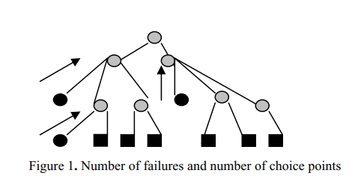
Existing System
7
Traditional timetable systems generally generate schedules by assigning subjects to available time slots while checking basic constraints. Some systems use optimization or search techniques, but when a major change occurs, the timetable may need to be regenerated or manually modified.
Advantages
Automates basic scheduling
Reduces manual effort
Can satisfy predefined constraints
Search-based approaches can systematically find solutions
Limitations
Difficult to handle dynamic changes
Faculty absence can disrupt existing schedules
Manual modification can introduce new conflicts
Entire timetable may need to be regenerated
Course sessions may not be evenly distributed
[Existing System Diagram / Screenshot]
Existing approach
Inputs
CSP Model
Backtracking
Full Regeneration
Cyber Security | Project Review – 1 | 2026-27

Slide 8
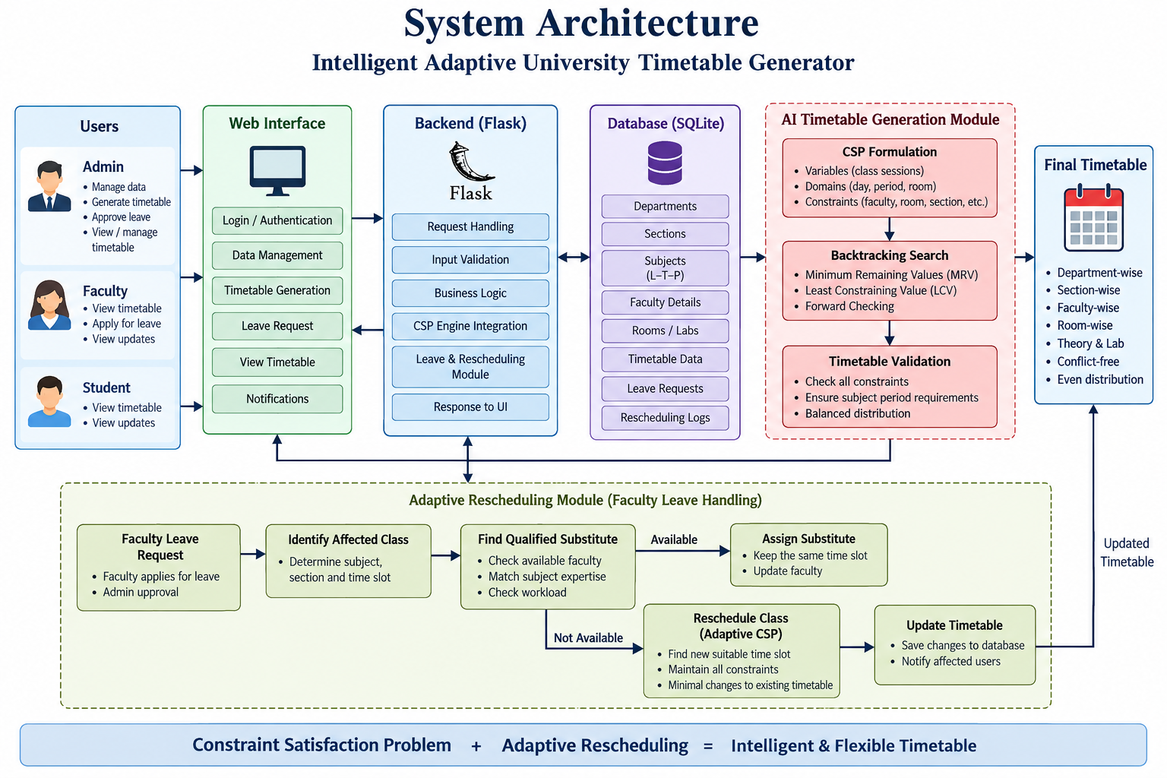
Proposed System
8
The proposed system models university timetable generation as a Constraint Satisfaction Problem (CSP) and uses AI-based search to generate a valid and balanced timetable.
Key Features
University-wide timetable generation
Handles multiple departments and sections
Considers faculty, room and section constraints
Uses Backtracking + MRV + LCV + Forward Checking
Distributes course periods evenly across the week
Supports theory and laboratory scheduling
Provides role-based access for Admin, Faculty and Students
[Proposed System Diagram]
Novelty – Adaptive Rescheduling
When a faculty member applies for leave:
Identify the affected class.
Search for a qualified and available substitute.
Else, reschedule only the affected class.
Preserve remaining timetable - minimum changes.
Cyber Security | Project Review – 1 | 2026-27

Slide 9
System Architecture / Block Diagram
9
INPUT
Departments • Sections • Courses
Faculty • Rooms • L/T/P
PREPROCESSING - CSP FORMULATION
Variables • Domains
Hard & soft constraints
CLASSICAL AI SEARCH
Backtracking
MRV • LCV • Forward Checking
OUTPUT
University Timetable
Role-based UI • Updated Timetable
VALIDATION & ADAPTATION
Conflict checks • Stability
Leave / Substitute / Reschedule
Cyber Security | Project Review – 1 | 2026-27

Slide 10
Methodology
10
1. Data Collection
The system collects curriculum information, departments, sections, faculty, classrooms and laboratories.
2. CSP Formulation
Each required weekly class session is represented as a CSP variable. Its domain contains valid combinations of day, period and room.
3. Constraint Checking
Avoid faculty, room and section conflicts.
4. AI Search
Apply Backtracking with MRV, LCV and Forward Checking.
5. Validation
Verify weekly subject requirements and timetable validity.
6. Adaptive Rescheduling Find a substitute for absent faculty or reschedule the affected class.
Cyber Security | Project Review – 1 | 2026-27

Slide 11
Technologies Used
11
Programming Language: Python
Framework / Library: Flask
Database: SQLite
Frontend: HTML, CSS, JavaScript
AI Techniques: CSP, Backtracking, MRV, LCV, Forward Checking
Tools / IDE: VS Code, Git/GitHub, Web Browser
Hardware: A standard laptop/desktop with Python support is sufficient. No specialized hardware is required.
Cyber Security | Project Review – 1 | 2026-27

Slide 12
Module Description
12
Module 1 – University Data Management
Maintains departments, sections, subjects, faculty, classrooms, laboratories and course offerings.
Module 2 – CSP Formulation
Converts timetable requirements into CSP variables, domains and constraints.
Module 3 – Constraint Validation
Checks faculty, room, section, room-type and weekly-period constraints to ensure timetable validity.
Module 4 – Optimized Search
Uses Backtracking with MRV, LCV and Forward Checking to intelligently search for timetable assignments.
Module 5 – Adaptive Timetable Rescheduling
Handles faculty leave requests, searches for qualified substitutes and, when necessary, reschedules only affected classes while preserving the remaining timetable.
Cyber Security | Project Review – 1 | 2026-27

Slide 13
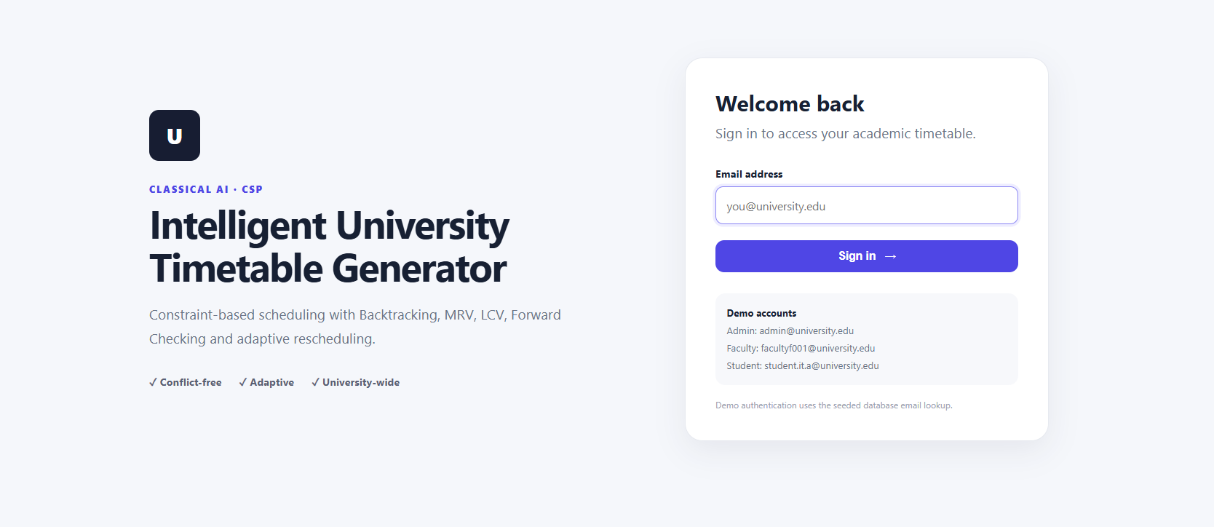
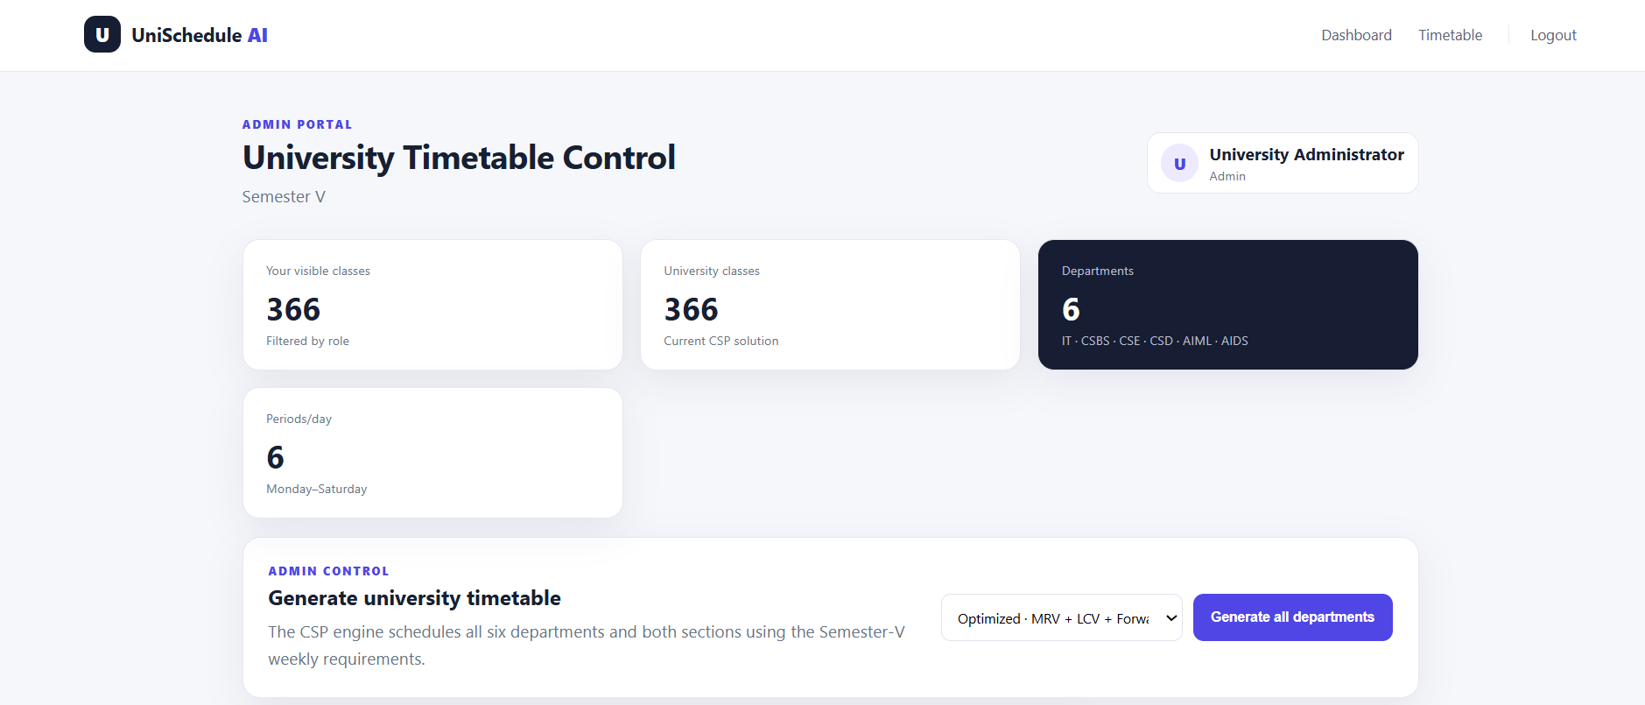
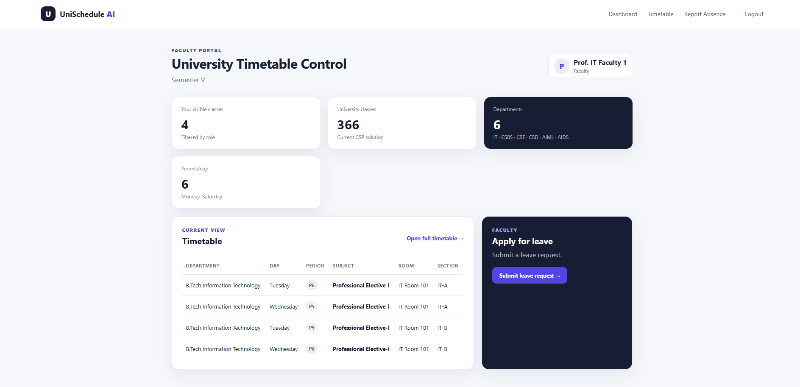
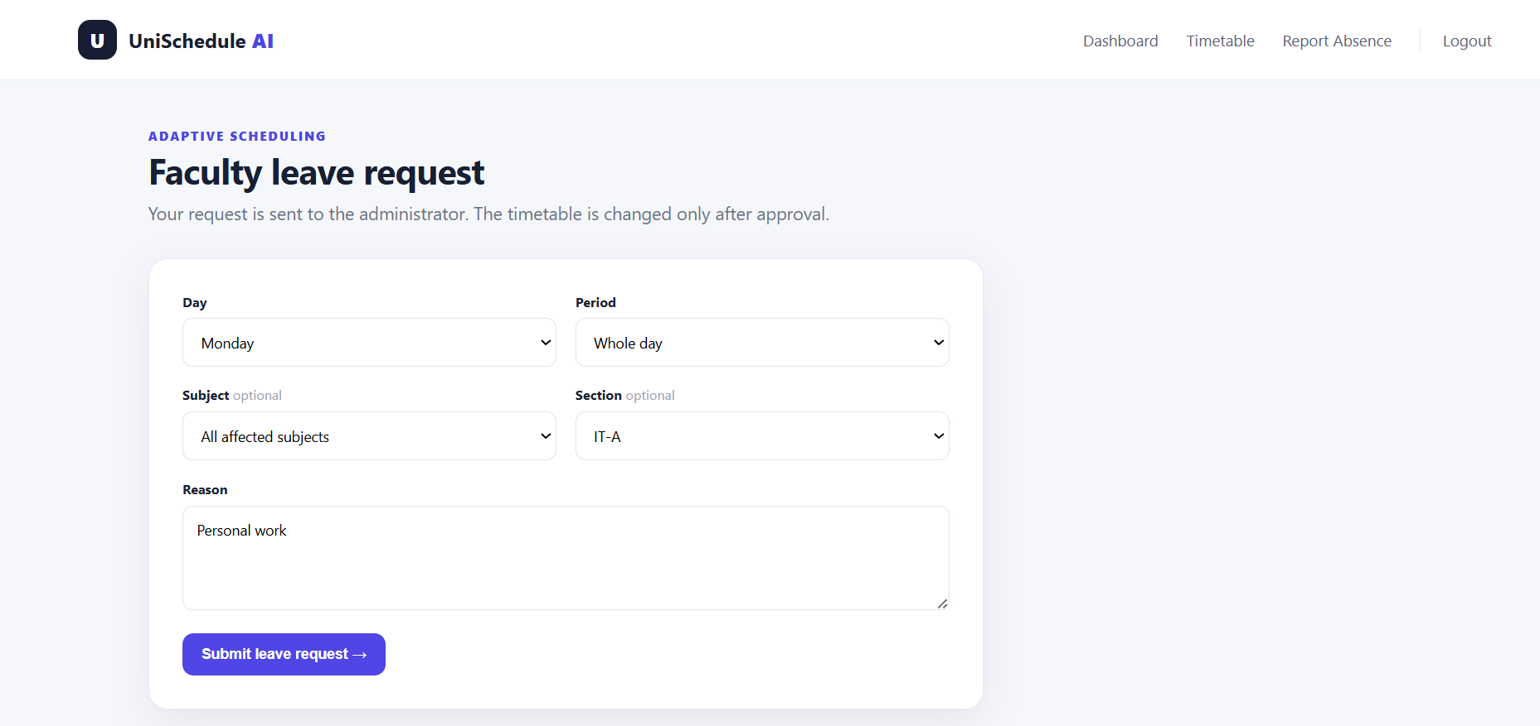
Output / Results
13
Cyber Security | Project Review – 1 | 2026-27

Slide 14
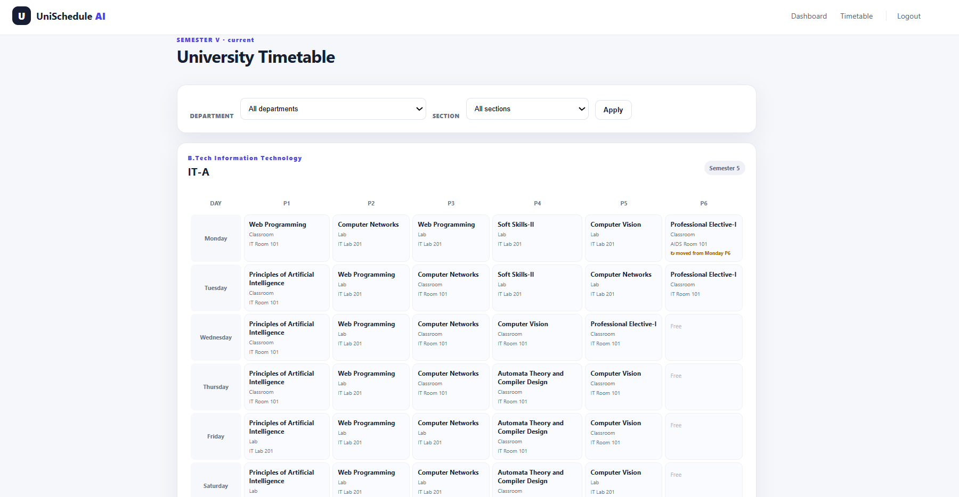
Output / Results
13
Cyber Security | Project Review – 1 | 2026-27

Slide 15
Project Schedule
14
Activity | Module 1 | Module 2 | Module 3 | Module 4 | Module 5
Description | Data Management | CSP Formulation | Constraint Validation | Optimized Search | Adaptive Rescheduling
Status |  |  |  |  | Pending
Cyber Security | Project Review – 1 | 2026-27

Slide 16
Current Progress
15
Completed
✓ Literature survey
✓ Problem identification
✓ Requirement analysis
✓ CSP formulation
✓ University-wide data model
✓ Timetable generation engine
✓ Backtracking implementation
✓ MRV, LCV and Forward Checking
✓ Constraint validation
✓ Multi-department support
✓ Flask-based UI
✓ Faculty leave request workflow
Remaining
☐ Substitute faculty selection
☐ Adaptive rescheduling logic
☐ Large-scale performance benchmarking
☐ More extensive disruption experiments
☐ Final UI refinement
☐ Final documentation and evaluation
Cyber Security | Project Review – 1 | 2026-27

Slide 17
Future Work
16
The current system can be extended into a complete university scheduling platform.
Future enhancements
Real-time notifications for timetable changes
Mobile-friendly student and faculty interface
Secure authentication and authorization
Automatic email/app notifications for approved leave
Better substitute ranking based on workload and expertise
Multi-day and emergency absence handling
Integration with university attendance systems
Larger-scale performance benchmarking
Historical timetable analysis
Cyber Security | Project Review – 1 | 2026-27

Slide 18
Conclusion
17
The project applies Classical AI and CSP techniques to automate university timetable generation. The system combines Backtracking, MRV, LCV and Forward Checking to produce valid and balanced schedules.
Key Contribution
The proposed adaptive rescheduling mechanism handles faculty absence by first finding a qualified substitute and, if unavailable, rescheduling only the affected class.
FROM
STATIC TIMETABLE GENERATION
TO
ADAPTIVE TIMETABLE MANAGEMENT.
Cyber Security | Project Review – 1 | 2026-27

Slide 19
References
18
[1] Zhang, L., & Lau, S. K. (2005). Constructing university timetable using constraint satisfaction programming approach. Proceedings of the International Conference on Computational Intelligence for Modelling, Control and Automation, 2, 55–60. https://doi.org/10.1109/CIMCA.2005.1631445
[2] Abdelraouf, I., Abdennadher, S., & Gervet, C. (2011). A visual entity-relationship model for constraint-based university timetabling. arXiv. https://arxiv.org/abs/1109.6112
[3] Ceschia, M., Di Gaspero, T., Schaerf, A., & others. (2022). Educational timetabling: Problems, benchmarks and state-of-the-art results. Annals of Operations Research.
[4] Cheng, C., Kang, L., Leung, N., & White, G. M. (2005). Investigations of a constraint logic programming approach to university timetabling. Lecture Notes in Computer Science.
[5] Burke, E. K., Mareček, J., Parkes, A. J., & Rudová, H. (2009). Decomposition, reformulation, and diving in university course timetabling. Operations Research Proceedings. https://arxiv.org/abs/0903.1095
Cyber Security | Project Review – 1 | 2026-27

